Slide 1

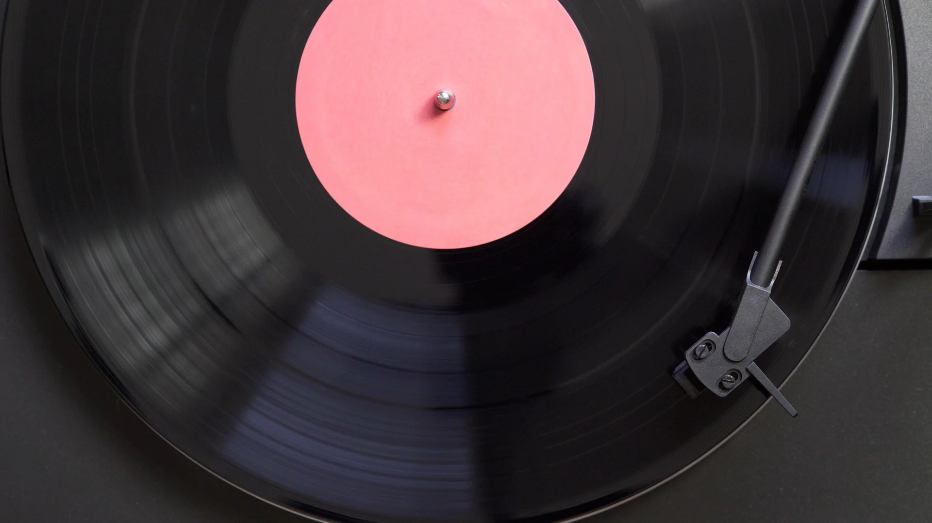
JUKE-BOX
Presented To : Vaibhav Diwan , Charul Bapna
Presented By – Shubham Chauhan

Slide 2
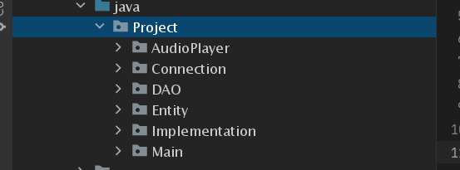

PACKAGES
To make a Clean Code ,I created a different Packages for their respective Classes

Slide 3
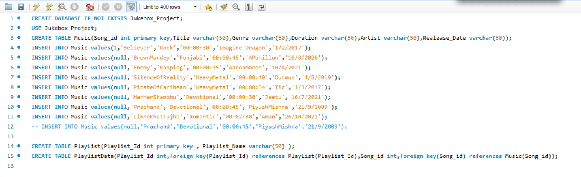
Data-Base Query

Slide 4
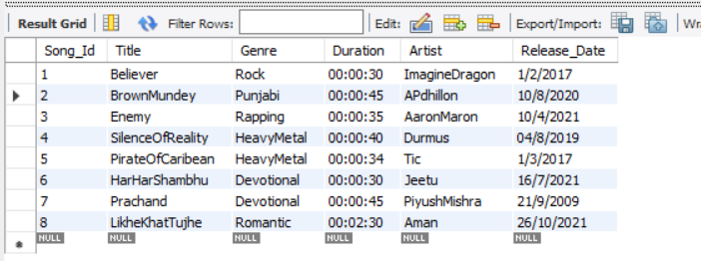
Song Table

Slide 5
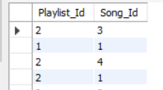
PlayList Table

Slide 6
PlayListData Table

Slide 7
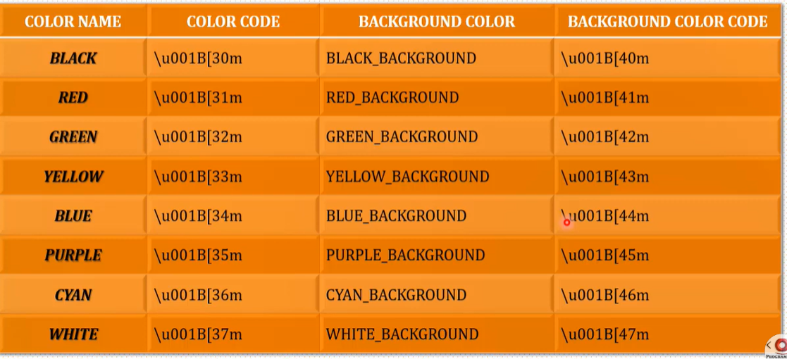
Color-Code
For Getting Output Text in Different Color

Slide 8
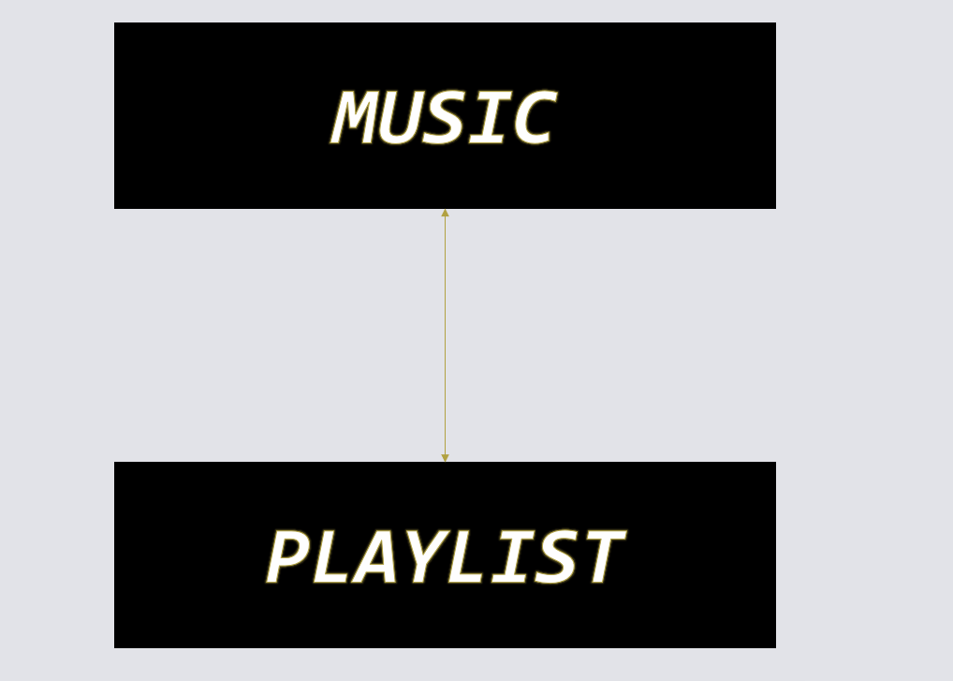
HAS-A

Slide 9
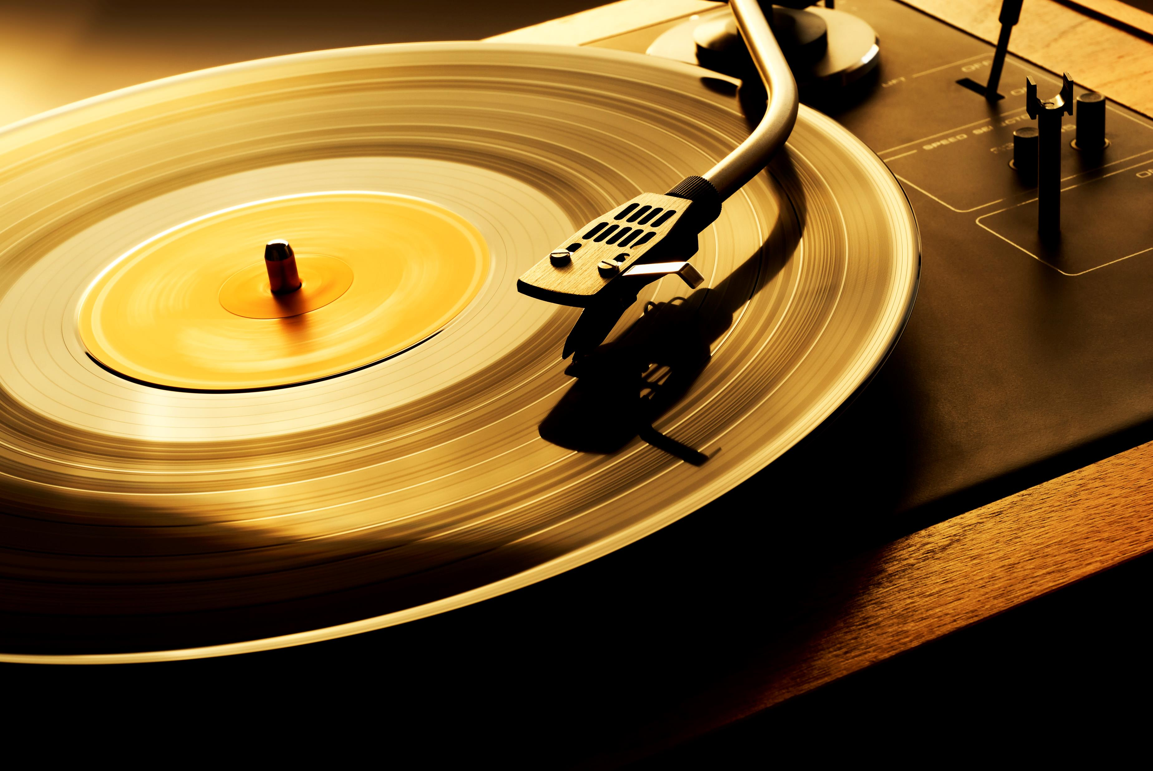
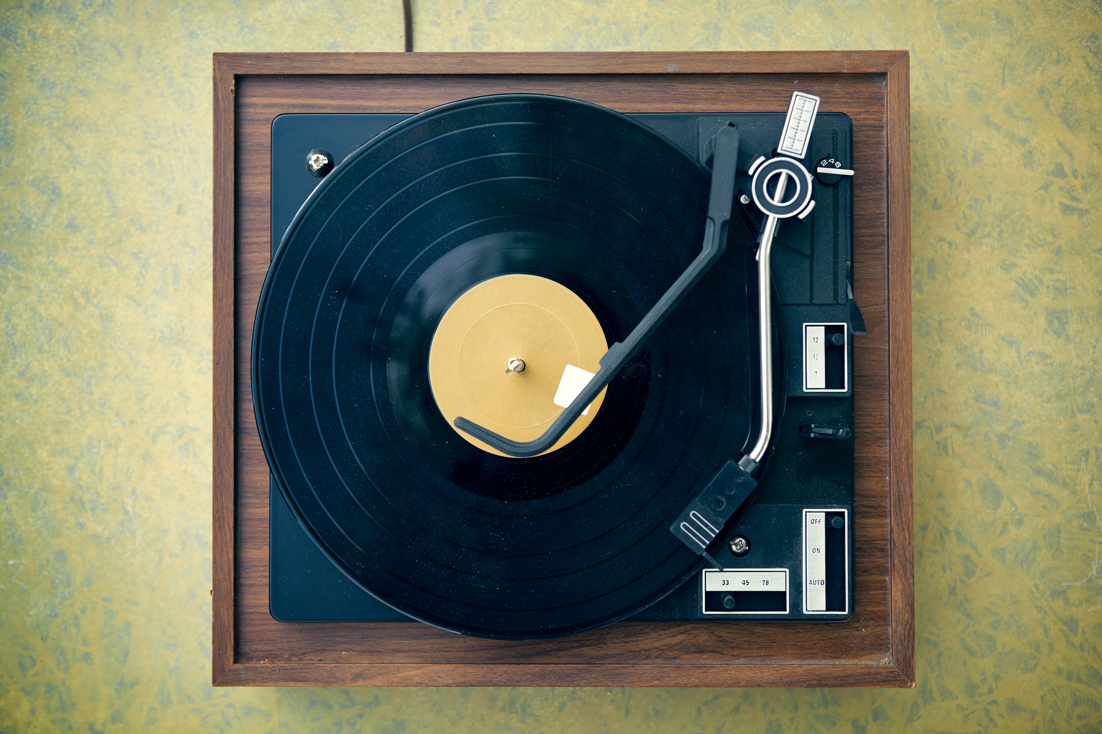
THANK - YOU

